Slide 1

Decoding Hit Songs: A Data-Driven Journey into Spotify’s Sound DNA
Presented by: Sk Mosaraf — B.Tech CSE Under Project Theme: The Manhattan EDA Challenge 2025

Slide 2
Problem Statement
This project is a deep dive into Exploratory Data Analysis (EDA) using a dataset of Spotify tracks. The goal is to perform a comprehensive analysis to understand the characteristics of the tracks, identify key relationships between different audio features, and uncover insights that could be used for tasks like music recommendation or understanding music trends.

Slide 3
Agendas
Data Descriptions
2. Univariate Analysis
3. Bivariate Analysis
4. Multivariate Analysis
5. Time Series Analysis
6. Outlier Analysis

Slide 4
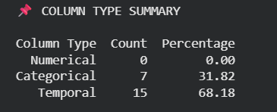
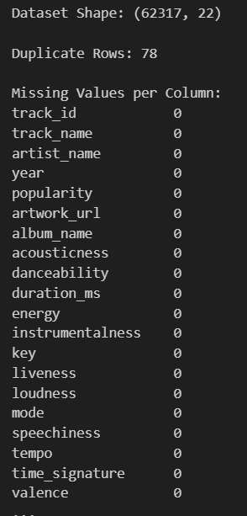
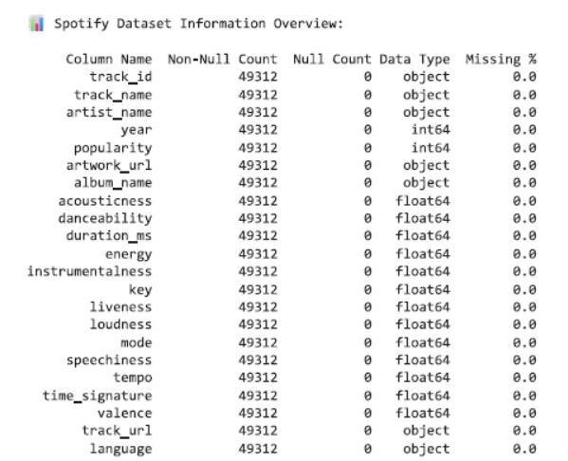
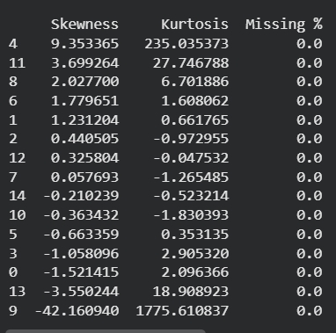
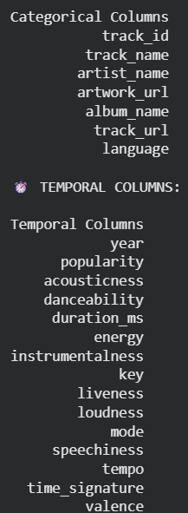
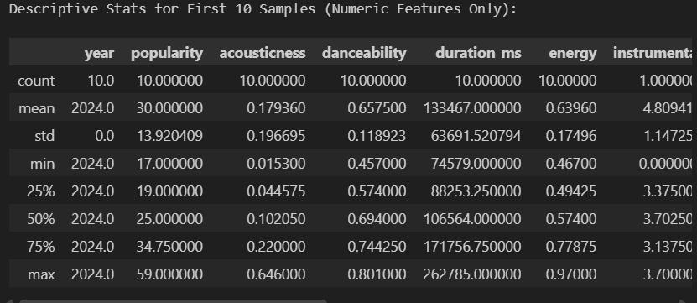
Data Descriptions

Slide 5
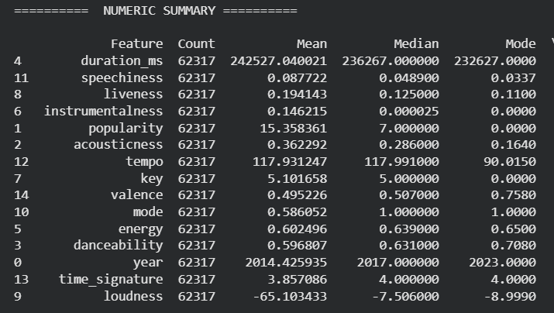
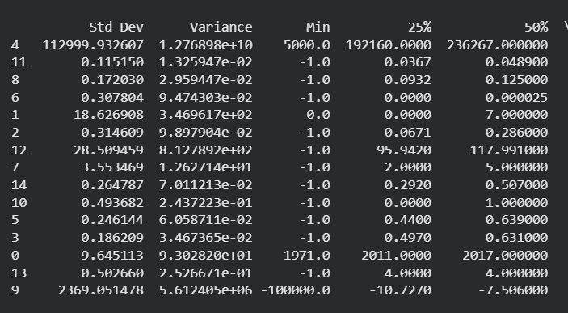
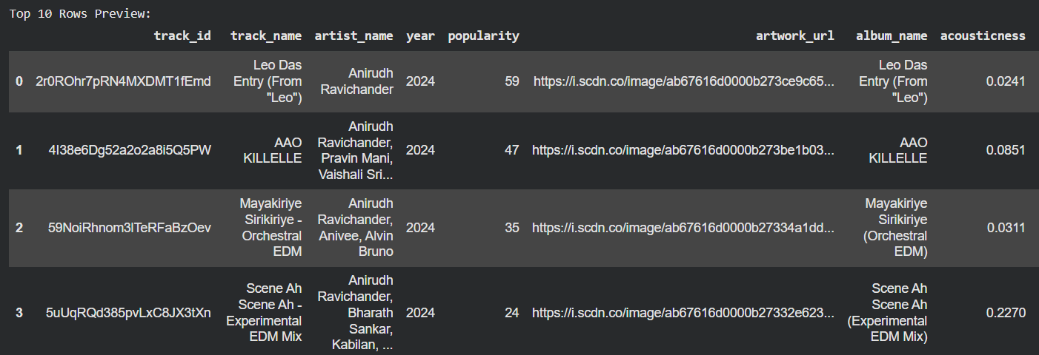

Slide 6
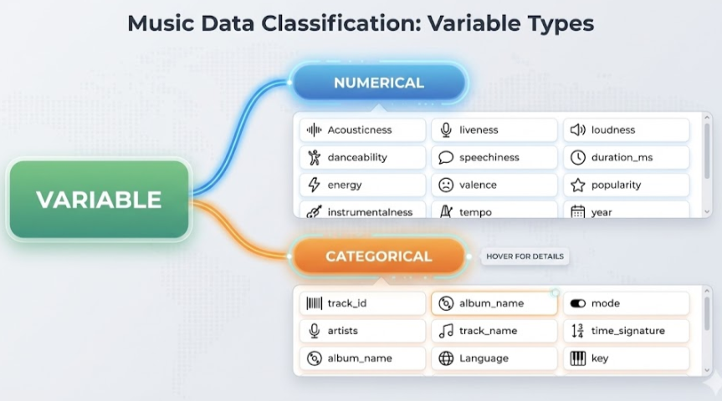
Data Classification
1️⃣ Numerical Variables
These are quantitative features that contain measurable, continuous, or integer values. They are used for statistical analysis and modeling.
2️⃣ Categorical Variables
These are qualitative features representing labels, categories, or names. They cannot be measured numerically.

Slide 7
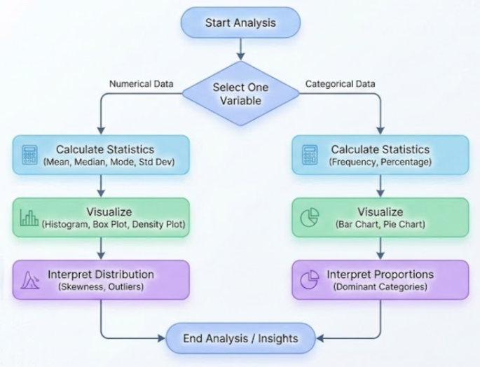
What is Univariate Analysis ?
Univariate analysis is a statistical technique that examines and analyzes one variable at a time. It focuses on understanding the variable’s distribution, central tendency, spread, and outliers to identify patterns and summarize its behavior.

Slide 8
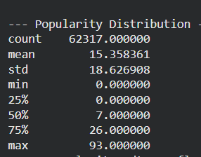
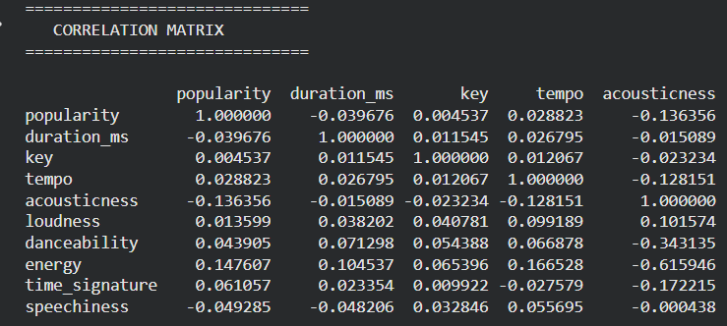
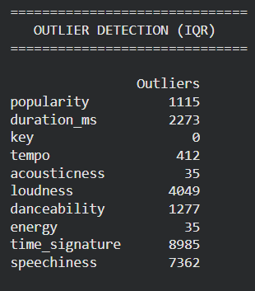
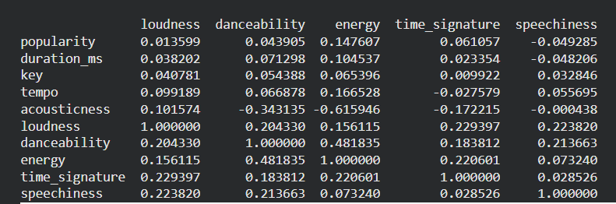
Univariate Analysis
A) STATISTICAL ANALYSIS OF NUMERICAL VARIABLES

Slide 9
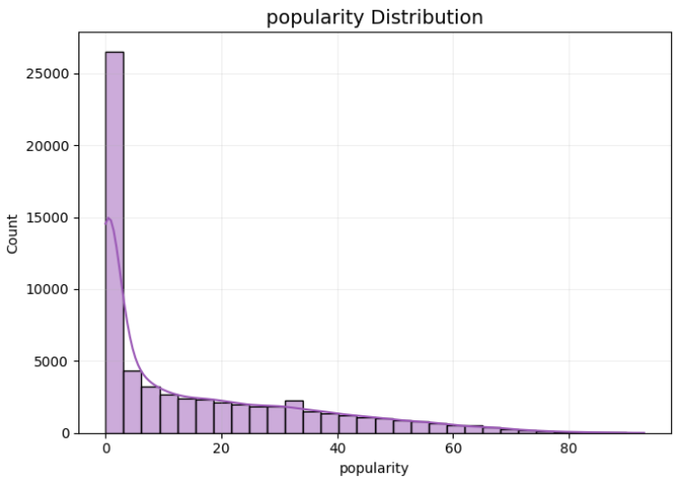
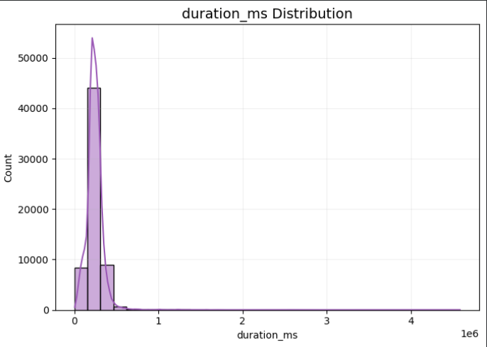
Univariate Analysis
The popularity distribution is heavily right-skewed, showing that most Spotify tracks have low engagement, while only a few achieve high popularity. This highlights the competitive and unequal nature of the streaming ecosystem and provides important context for deeper analysis, modeling, or prediction tasks.
The duration_ms distribution shows a typical 2–5 minute song length for most tracks, but with a heavy right-skewed tail caused by unusually long audio tracks such as mixes, podcasts, or metadata noise—highlighting the need for outlier handling in further analysis.

Slide 10
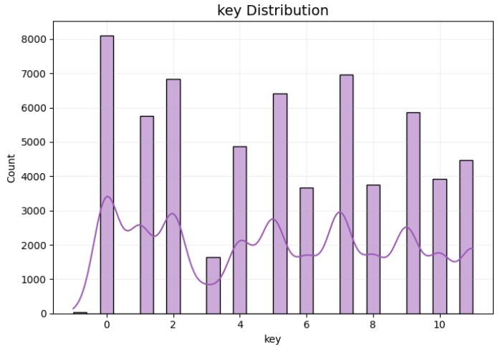
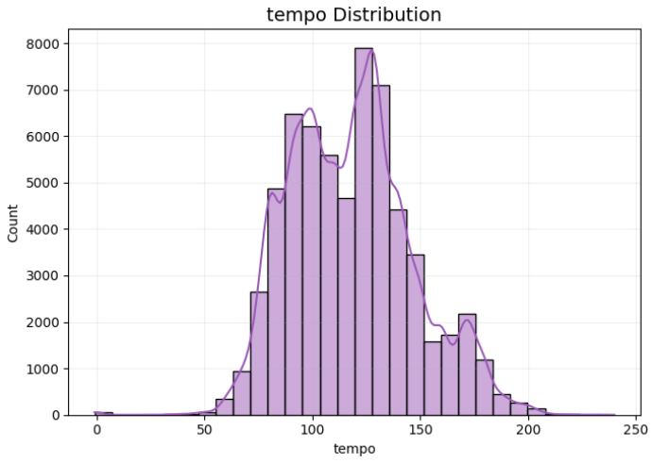
Univariate Analysis
The key distribution is fairly balanced across all 12 musical keys, with common keys like C, G, and D appearing most frequently—reflecting typical Western music composition patterns while showing broad harmonic diversity in the Spotify dataset.
The tempo distribution is multi-modal with strong peaks in the 90–140 BPM range, reflecting the rhythmic characteristics of popular genres such as pop, hip-hop, EDM, and rock, while also showcasing minor clusters from slower and faster niche genres

Slide 11
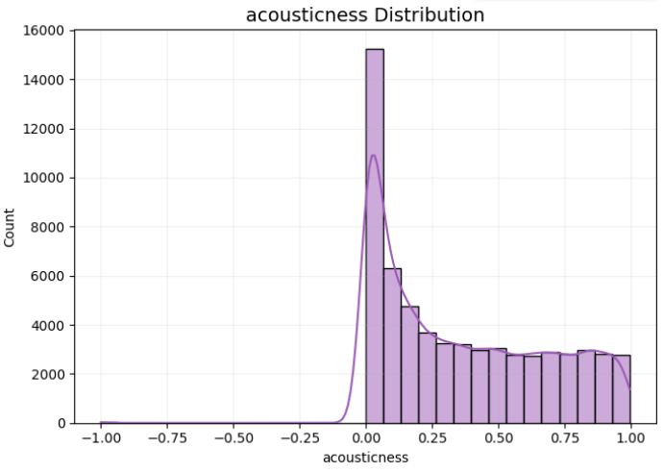
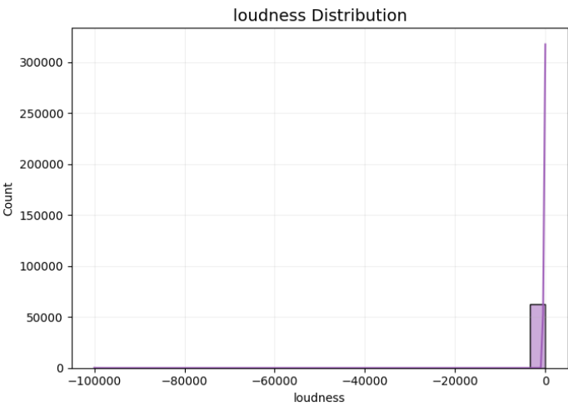
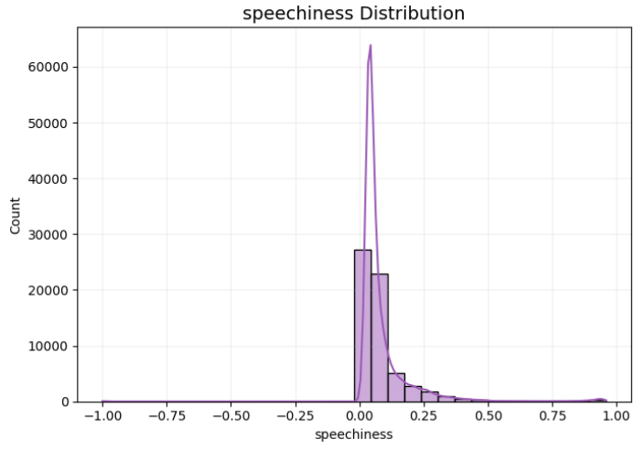
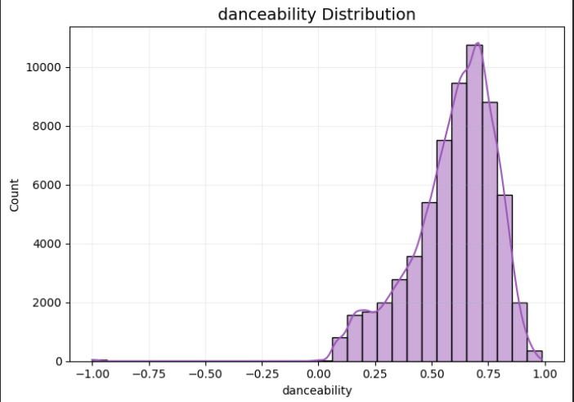
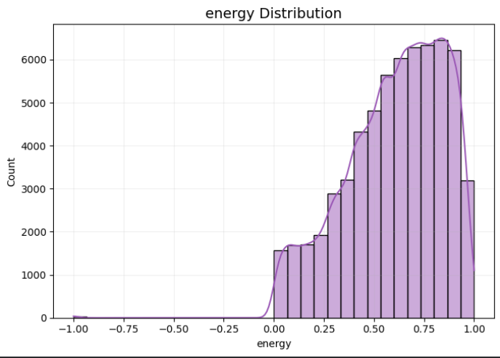
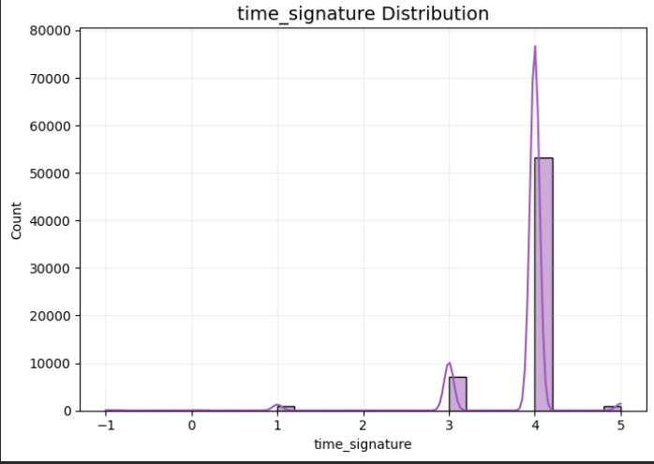
Univariate Analysis

Slide 12
Univariate Analysis
Acousticness Distribution :
Loudness Distribution :
Speechiness Distribution :
The acousticness distribution shows that the vast majority of Spotify tracks are electronically produced with very low acoustic content, while fully acoustic songs exist but make up a smaller portion—revealing strong modern production trends in the music landscape.
The loudness distribution appears extremely skewed due to corrupt or placeholder values below –60 dB, but the true audio loudness data lies between –5 and –30 dB; cleaning these invalid values is essential for accurate analysis.
The speechiness distribution is heavily skewed toward near-zero values, indicating that most Spotify tracks contain almost no spoken-word content, while highly speech-driven audio (podcasts and speeches) is extremely rare in the dataset.
Danceability Distribution
Energy Distribution
Time Signature Distribution
The danceability distribution shows that most Spotify tracks are moderately to highly danceable, with a strong peak around 0.7, reflecting modern music’s rhythmic emphasis, while only a small fraction of tracks exhibit low danceability or invalid values requiring cleaning
The energy distribution shows that most Spotify tracks are highly energetic—with a strong peak around 0.8—reflecting modern production styles and listener preferences for upbeat, dynamic music, while very low-energy songs and negative values appear rarely.
The time signature distribution is overwhelmingly dominated by 4/4 (common time), with a smaller 3/4 presence and only rare instances of complex or invalid signatures, reflecting the rhythmic uniformity of modern commercial music

Slide 13
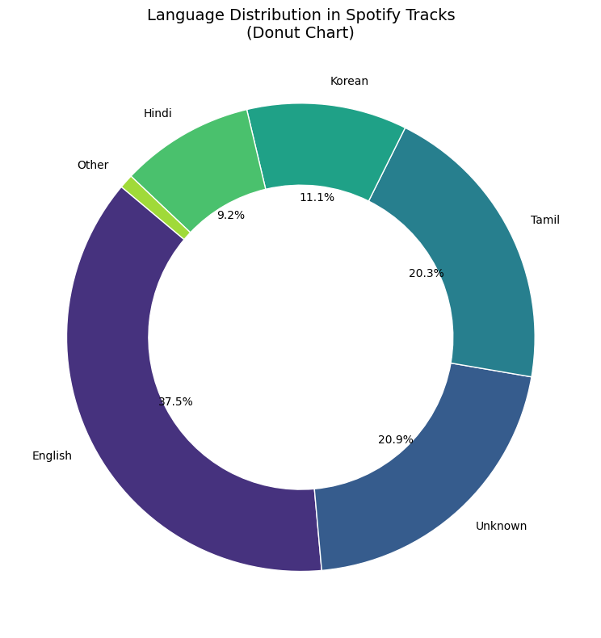
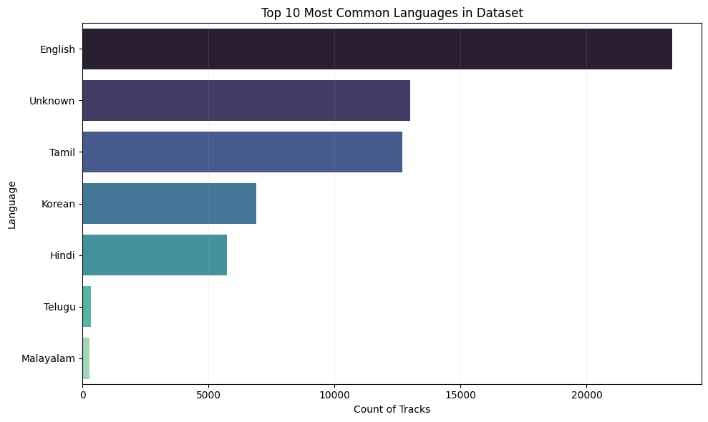
Univariate Analysis
Categorical Features Visualization
Language Distribution in Spotify Tracks
The donut chart shows that English dominates the Spotify dataset, while Tamil, Korean, and Hindi also hold significant shares, reflecting a diverse multilingual catalog with substantial Asian influence and some metadata gaps represented by the large “Unknown” category.
Interpretation & Insights
The dataset is heavily influenced by global mainstream markets
English continues to dominate the digital music space.
Strong Asian language presence
Tamil, Hindi, and Korean together make up a large portion, showing the dataset may be India/Asia-heavy.
Unknown language share is high
This indicates metadata inconsistencies that may require cleaning before language-based analysis.

Slide 14
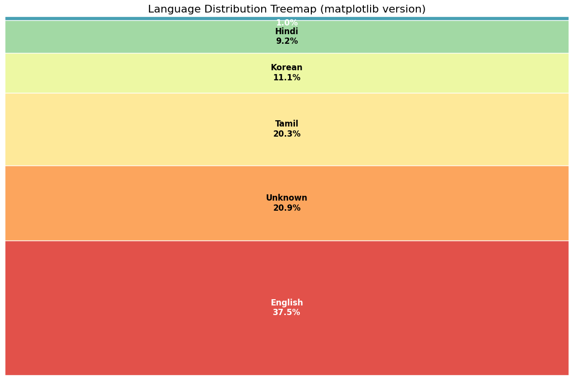
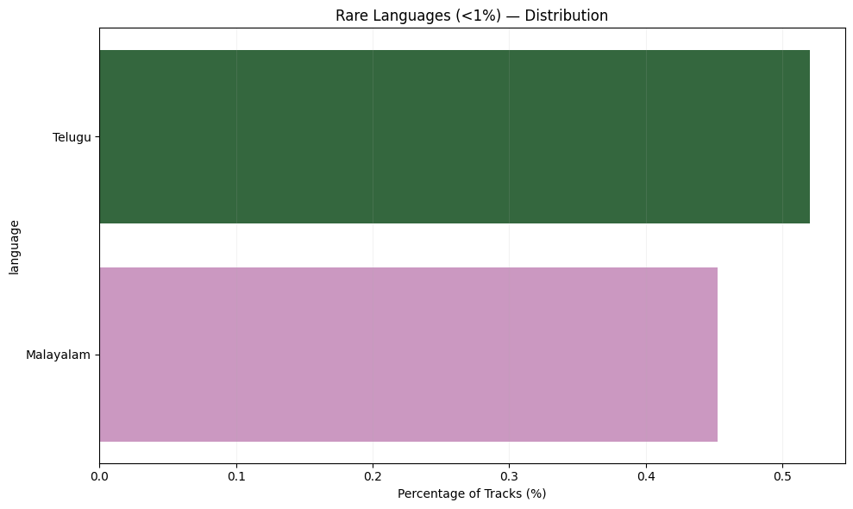
Univariate Analysis
Language Distribution Treemap
The treemap reveals that English dominates the dataset, while Tamil, Korean, and Hindi contribute substantial regional diversity, and a large “Unknown” category highlights significant metadata gaps
Rare Languages (<1%)
The rare-language distribution shows that Telugu and Malayalam each contribute less than 1% of the dataset—indicating limited but meaningful representation of South Indian regional music within Spotify’s global catalog.

Slide 15
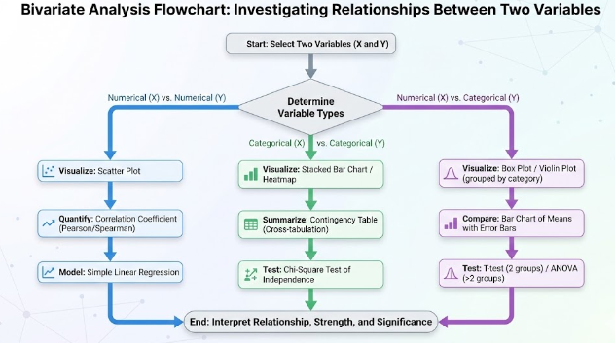
What is Bivariate Analysis ?
Bivariate analysis is a statistical technique used to examine and analyze the relationship between two variables at the same time. It helps determine whether the variables are related, how strongly they are related, and what type of relationship (positive, negative, or none) exists between them.

Slide 16
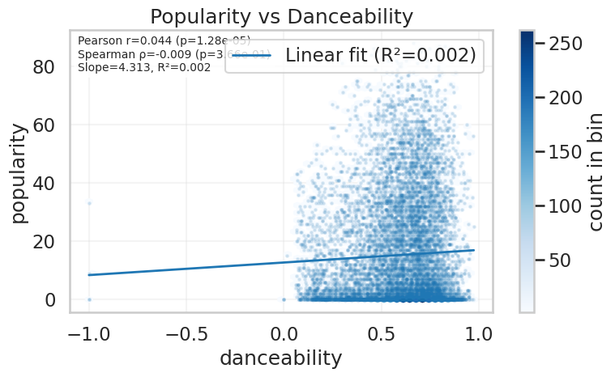
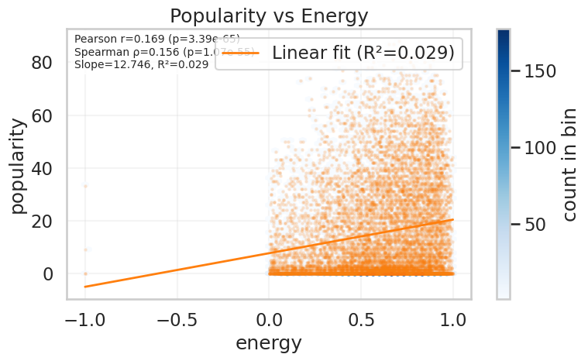
Bivariate Analysis
Popularity vs Danceability
Popularity vs Energy
The scatterplot shows that danceability has an extremely weak and practically meaningless relationship with popularity (R² = 0.002), indicating that a song’s danceability has little influence on how popular it becomes.
While energy shows a weak positive correlation with popularity, the extremely low R² value (0.029) indicates that energy plays only a minor role in determining a song’s success, and popularity is mostly influenced by factors outside the audio feature itself.

Slide 17
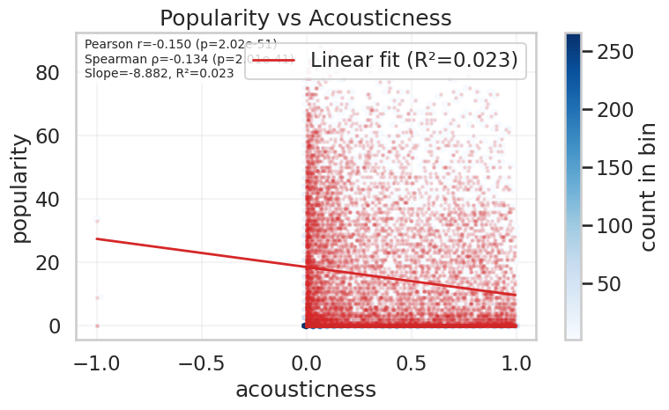
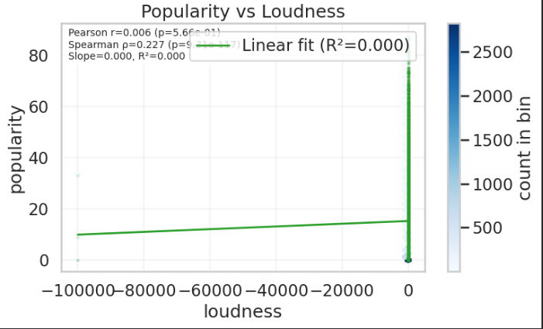
Bivariate Analysis
Popularity vs Acousticness
Popularity vs Loudness
The plot shows a flat, near-zero relationship between loudness and popularity (R² = 0.000), indicating that a track’s volume has no meaningful effect on its success, and extreme invalid loudness values distort the visualization.
Acousticness shows a very weak negative correlation with popularity (R² = 0.023), indicating that while more electronic tracks tend to be slightly more popular, acousticness alone does not meaningfully determine a song’s success.

Slide 18
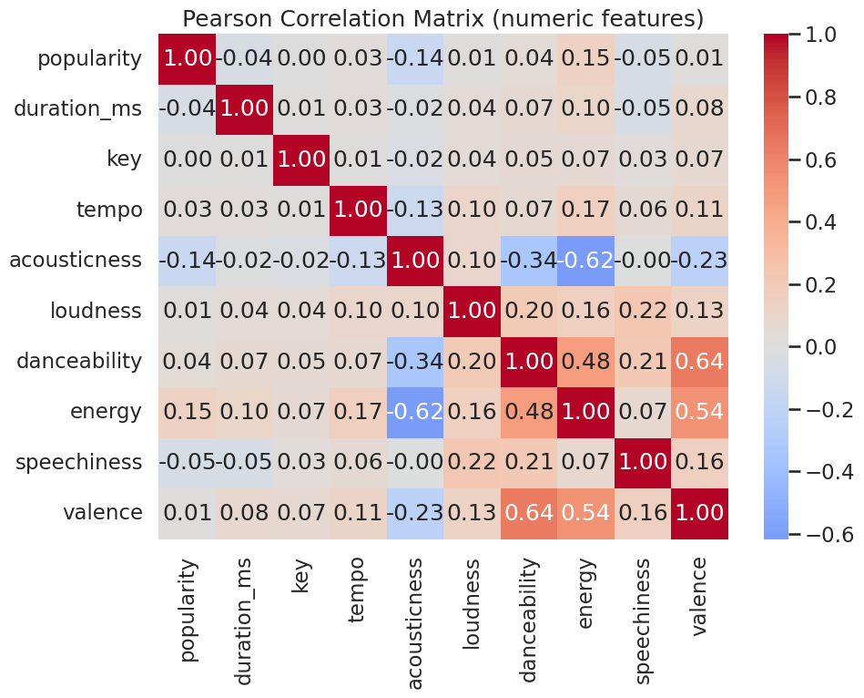
Bivariate Analysis
The correlation matrix shows meaningful relationships between musical features (energy, danceability, valence, acousticness), but these features have almost no linear relationship with popularity, confirming that popularity is driven by external factors rather than audio characteristics.
Takeaways
🎯 1. Popularity is not explained by audio features.
All correlations with popularity are extremely small.
🎯 2. Audio features strongly correlate with each other in musically meaningful ways.
🎯 3. Energy, valence, and danceability form a tightly connected cluster of upbeat, happy, dance-friendly music attributes.
🎯 4. Acousticness is the opposite of energy/danceability — aligns with softer, quieter genres.

Slide 19
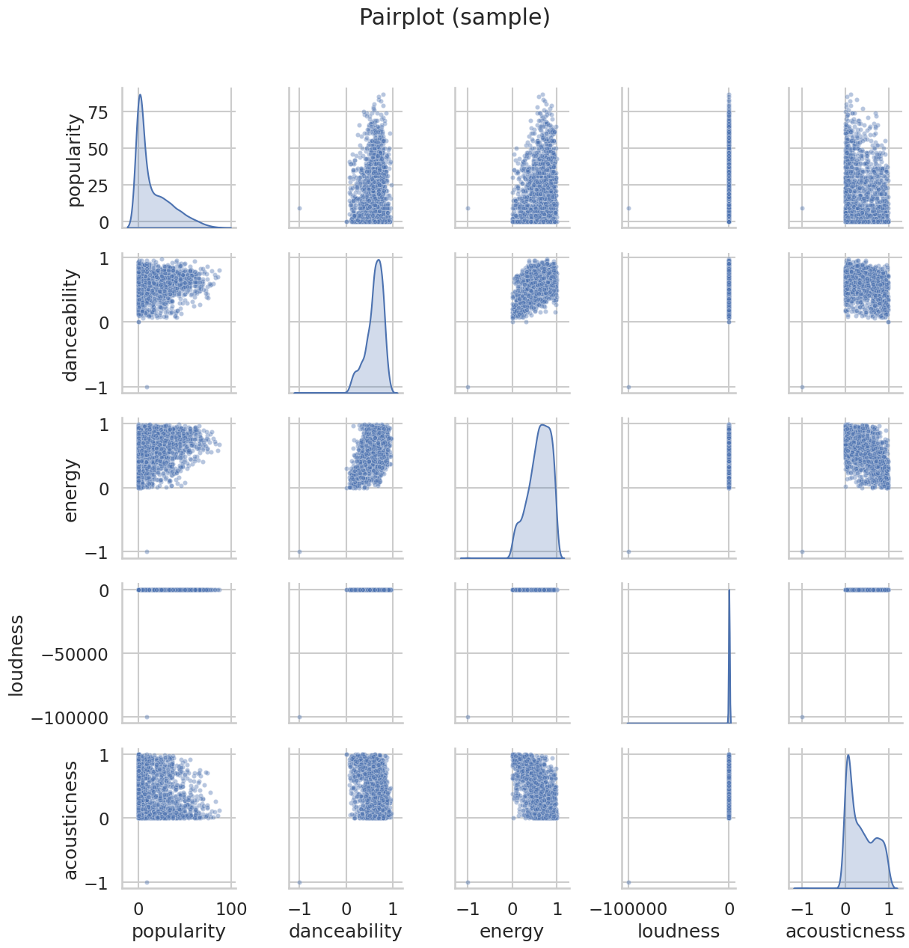
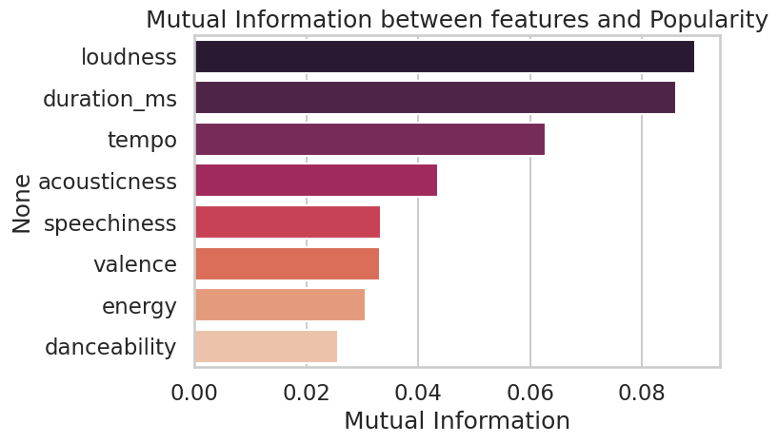
Bivariate Analysis
PAIRPLOT (Sample)
Analysis of the Mutual Information (MI) Scores with Popularity
The MI chart reveals that popularity cannot be predicted from any single feature, but:
Loudness, duration, and tempo provide the strongest clues Acousticness, valence, speechiness, and energy have moderate impact Danceability is surprisingly weak
Together, these insights help form a data-driven understanding of what influences popularity in Spotify tracks.
The pairplot shows the relationships among five key Spotify audio features—popularity, danceability, energy, loudness, and acousticness—using scatterplots and distribution plots.

Slide 20
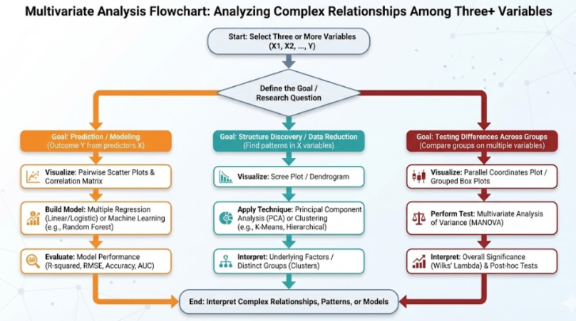
What is Multivariate Analysis ?
Multivariate analysis is a statistical technique used to examine three or more variables simultaneously to understand complex relationships, patterns, and interactions among them. It helps identify how multiple factors together influence outcomes, uncover hidden structures in data, and build prediction or classification models.

Slide 21
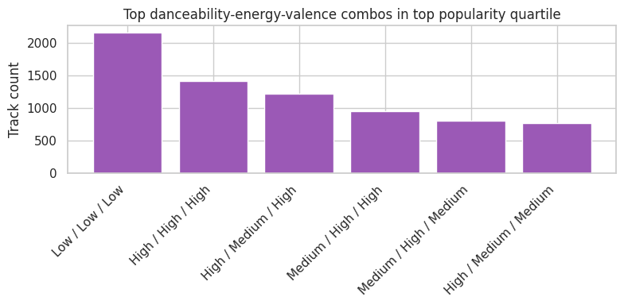
Multivariate Analysis
Key Insights
Two types of songs dominate popularity:
Low-energy, low-valence ballads / mellow songs
High-energy, high-valence dance-pop hits
This means there are two successful extremes:
Sad / calm / emotional music
Happy / energetic / danceable music
Mid-range songs also perform well
Combinations involving:
Medium energy
Medium–high valence
High danceability still consistently appear in the top 6.
Danceability is not the strongest indicator of popularity
Both low and high danceability categories appear in popular songs. This suggests danceability alone doesn’t determine popularity.
Energy & Valence together matter more
Combinations with high energy + high valence frequently show up in popular songs, matching the trend of upbeat radio hits.

Slide 22
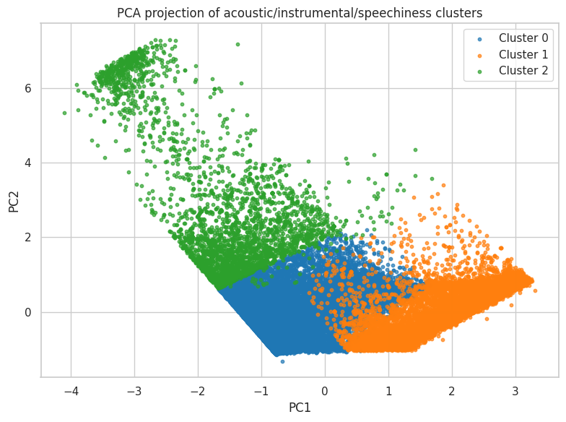
Multivariate Analysis
Overall Insight
The PCA + clustering tells us that Spotify tracks can be divided into three broad audio identities:
Cluster 0 (Blue) – Mainstream songs
Balanced acousticness, instrumentalness, and speechiness.
Cluster 1 (Orange) – Speech-heavy songs
Hip-hop, rap, spoken-word, tracks with higher vocal presence.
Cluster 2 (Green) – Acoustic & Instrumental songs
High acousticness, likely calm, organic, or instrumental tracks

Slide 23
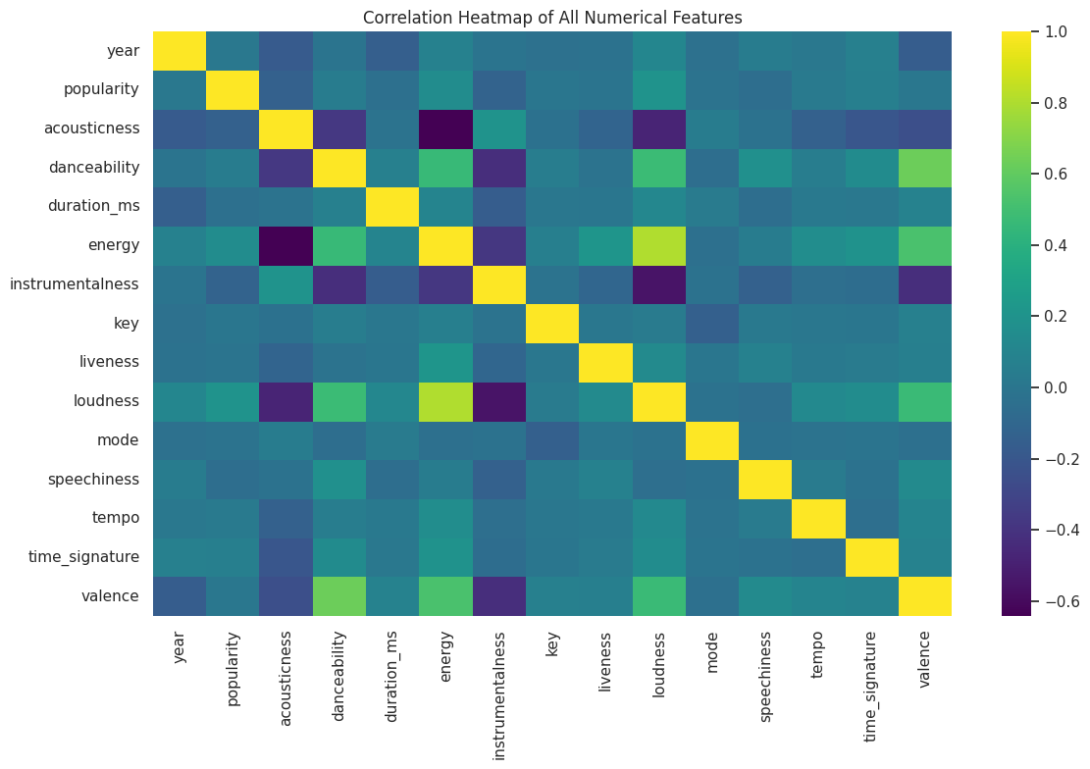
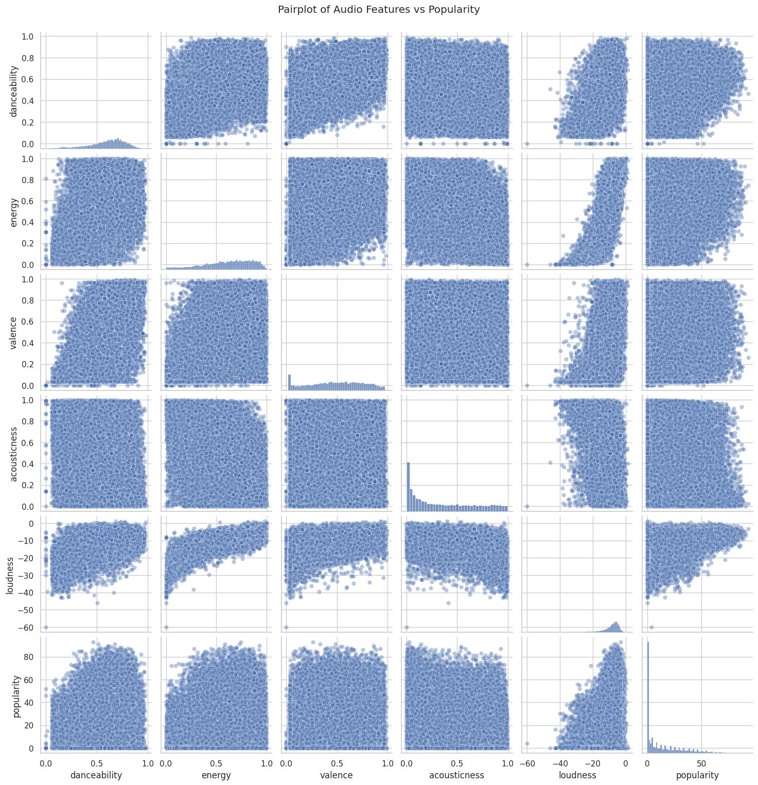
Multivariate Analysis
Correlation Heatmap Analysis
Popularity has no strong audio correlation.
Energy, loudness, and danceability form a high-energy cluster.
Acousticness and instrumentalness form a soft/acoustic cluster.
Most features are weakly connected → dataset has high diversity.
Heatmap reveals the underlying structure but confirms that predicting popularity from audio alone is challenging.
Pairplot of Audio Features vs Popularity — Analysis
The pairplot reveals that while Spotify audio features show clear internal structure—such as energy being tied to loudness and danceability—these characteristics have only weak relationships with popularity. Popular tracks exist across the full spectrum of danceability, energy, and valence. This suggests that song success relies far more on external factors (artist recognition, playlist exposure, marketing) than on raw acoustic properties.

Slide 24
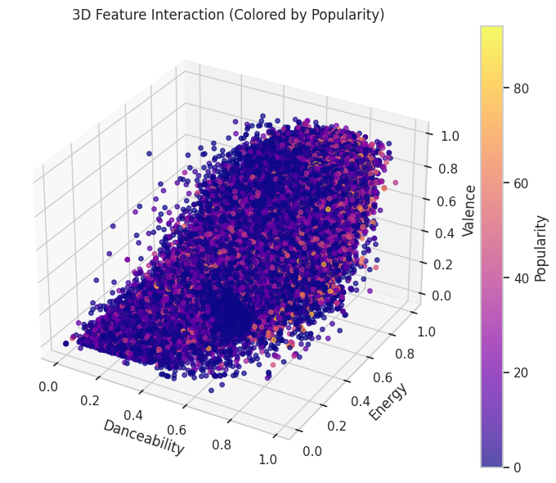
Multivariate Analysis
Main observations
1. Positive relationships among the three features
There is a clear positive trend across the three axes: as danceability ↑, energy ↑ and valence ↑ tend to increase too.
This creates a diagonal band from (low, low, low) → (high, high, high). Musically: energetic, danceable tracks also tend to be “happier”.
2. Popularity is scattered but shows weak concentration
High-popularity points (yellow/orange) are present throughout the volume, but slightly more concentrated in the mid–high energy & valence region.
There are popular tracks at many combinations (including moderate danceability), so popularity is not tightly coupled to a single feature or corner of the space.
3. No single “hit region”
There is no isolated cluster where all the most popular songs sit. Instead popularity forms a gradient — a few brighter spots appear near higher energy/valence/danceability but many bright points are scattered elsewhere.
4. Dense central mass = mainstream production style
The densest region (many blue/purple points) sits at moderate-to-high danceability and energy with medium valence — this is the typical modern-production signature (pop/EDM/hip-hop).
.
3-D Feature Interaction
Axes: X = Danceability, Y = Energy, Z = Valence (0 → 1 scale).
Color = Popularity (purple = low, yellow = high).
Plot shows a dense cloud of songs filling a roughly triangular / wedge-shaped volume in this 3-D space

Slide 25
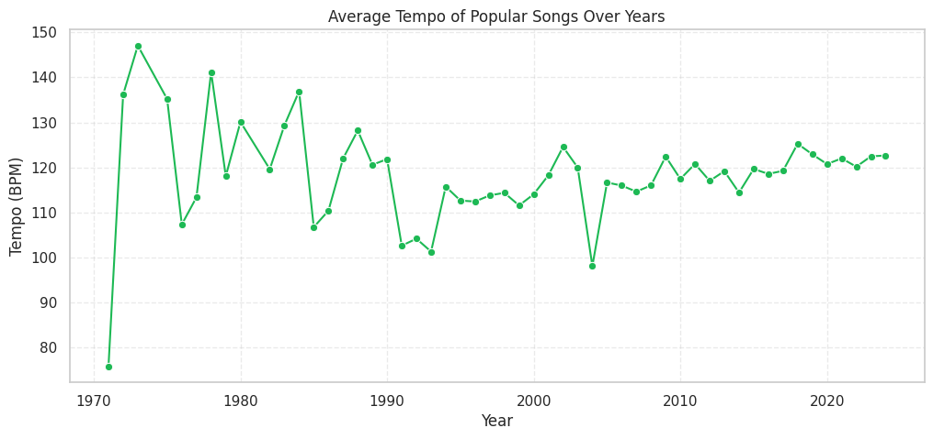
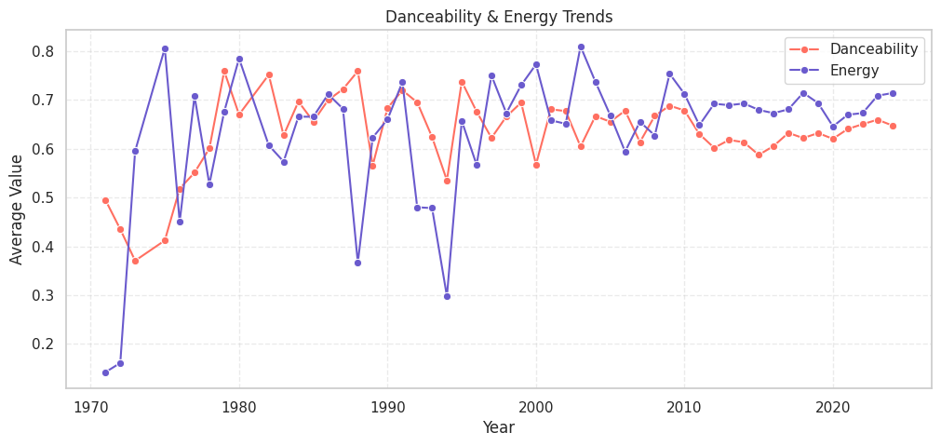
Time Series Analysis
Analysis: Average Tempo of Popular Songs Over the Years :
Popular songs have evolved from highly variable tempos in the 70s to a stable, playlist-friendly range in the 2000s and beyond. Today’s hits usually fall around 115–122 BPM, reflecting modern listening preferences and the influence of dance/electronic production.
Danceability & Energy Trends Analysis:
The trend lines show that popular music has undergone major stylistic shifts across decades. After fluctuating significantly in the 70s–90s, both danceability and energy have stabilized since the 2000s, reflecting modern production consistency. Recent years show rising values again due to the influence of dance, electronic, and global pop genres. Overall, popular songs have become increasingly rhythmic and energetic over time.

Slide 26
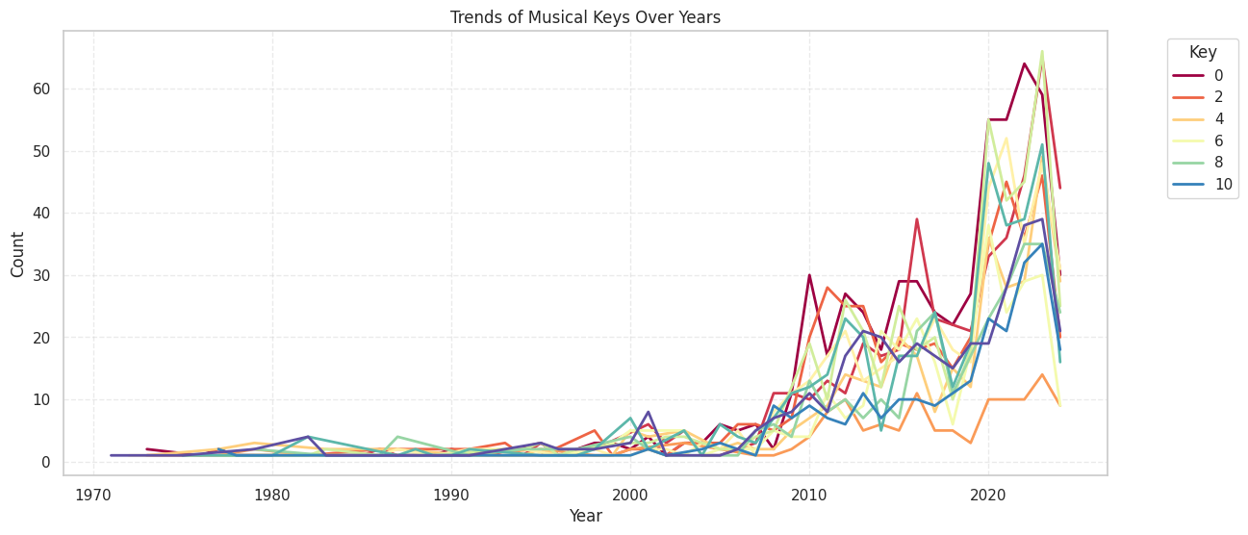
Time Series Analysis
Analysis: Trends of Musical Keys Over Years
🔹 Before 2000 → very few songs per year in dataset
🔹 After 2010 → rapid growth in all keys
🔹 Keys 0, 6, 8, 10 dominate modern music
🔹 Keys 2 & 4 are less popular in the digital era
🔹 Strong surge after 2020 → Spotify era boom
🔹 No single universal key — music is diverse
🔹 Pattern reflects modern genre trends (pop, EDM, hip-hop)
High Volatility Suggests Production Trends
🔹 The spikes and dips across years show:
🔹 Trendy keys can become dominant for 2–5 years
🔹 Then another key rises
🔹 Probably related to:
🔹 Producer preference
🔹 Tuning choices
🔹 Genre popularity cycles
🔹 Vocal tendencies in mainstream artists

Slide 27
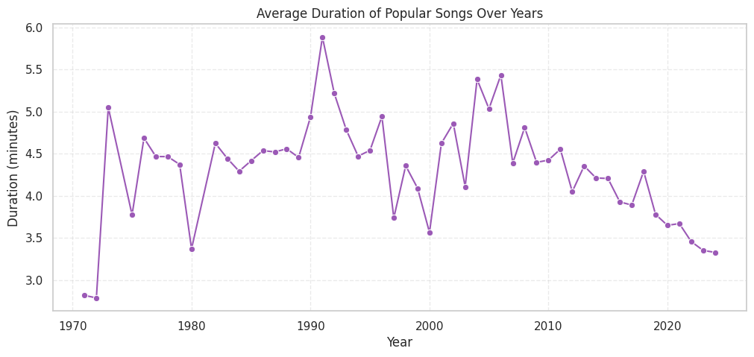
Time Series Analysis
Analysis: Average Duration of Popular Songs Over Years
Popular songs have become significantly shorter over time.
1970–1995: Songs were long, often 4.5–6 minutes.
1990s: Length peaks at nearly 6 minutes.
2000–2010: Slight decrease begins.
2010–2023: Sharp drop as average duration falls to about 3.3 minutes.
🎯 Overall Trend:
Popular songs today are almost 40% shorter than in the early 1990s. The modern music industry favors shorter, more repeatable, and algorithm-optimized tracks.

Slide 28
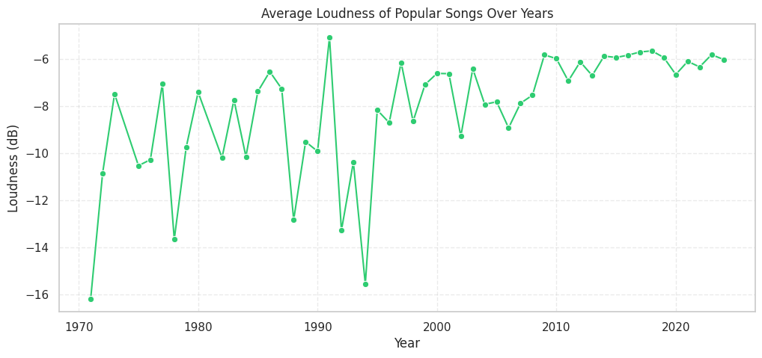
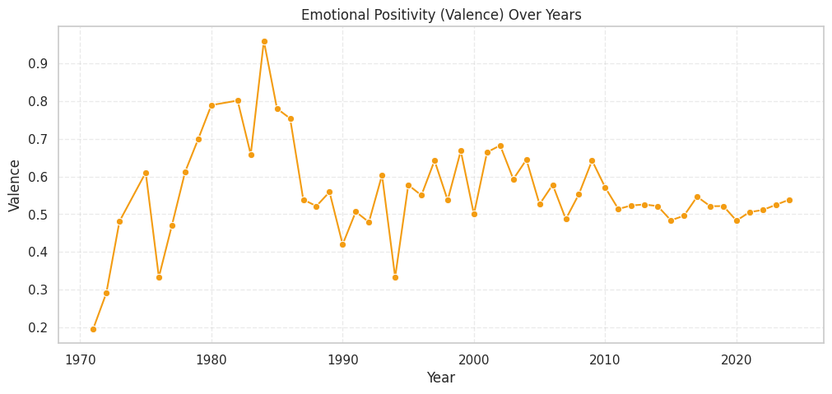
Time Series Analysis
Analysis: Average Loudness of Popular Songs Over the Years
Popular songs have become significantly louder over the past five decades. The average loudness increased from around −12 dB in the 1970s to approximately −5 dB in recent years, driven by changes in music production and the “Loudness War.” Since 2010, loudness has stabilized due to the influence of modern streaming platform normalization standards.
Analysis of Emotional Positivity (Valence) Trend in Popular Songs (1970–2023)
Popular music has become less “happy” over the decades.
1970s–1980s: Happiest era (peak positivity).
1990s–2000s: More balanced emotional tone.
2010–2023: Shift toward darker, moodier, lower-valence music.
What this means:
Modern music tends to express more introspection, sadness, and emotional complexity, compared to the high-energy feel-good songs of earlier decades.

Slide 29
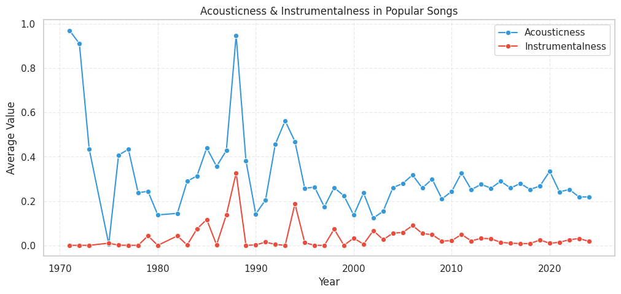
Time Series Analysis
Key Observations
Early 1970s: Very high acousticness (0.9–1.0). → Popular music was heavily acoustic—guitars, pianos, live band recording.
Late 1970s–1980s: Sharp drop into the 0.2–0.4 range. → Reflects the shift toward synth-pop, electronic production, and digital recording.
1990s–2000s: Acousticness stays low (0.15–0.30). → Rise of pop-rock, hip-hop, EDM influence.
2010s–2023: Stabilizes around 0.22–0.30, slight fluctuations. → Modern pop uses mostly electronic production with occasional acoustic elements.
🔴Overall Meaning
Popular songs have become less acoustic over the decades as music production shifted from live instruments to digital/electronic tools.

Slide 30


Outlier Analysis
Outlier Analysis of the Year Distribution Plot
The distribution of song release years is highly skewed toward recent years. Older years (1970–1990) appear as low-frequency outliers, while the most recent years—especially 2023—form strong high-frequency outliers. This indicates either an explosion in modern music production or dataset bias toward recent tracks.
Outlier Analysis of Song Release Years (IQR Method)
Using the IQR method, earlier years (1970–1995) appear as outliers due to low track counts in the dataset. From the mid-90s onward, especially after 2010, the number of songs per year becomes stable and consistently high, eliminating outliers. This shift reflects the expansion of digital music and improved dataset completeness in recent years.

Slide 31

Outlier Analysis
Outlier Analysis of the “Year” Boxplot
Key Takeaways
✔ Modern years dominate the dataset
✔ Older years are statistically rare → flagged as outliers
✔ The boxplot shows clear time-based imbalance
✔ Useful when explaining historical biases in your dataset
The dataset is highly skewed toward recent music, with the majority of songs released between 2010 and 2022. Earlier years—from the 1970s through the 1990s—appear as outliers because they are much less represented in the dataset. This reflects either a bias in Spotify’s catalog, user listening behavior, or the dataset itself sampling modern music more heavily

Slide 32


Outlier Analysis
Analysis of the Violin Plot for Year
The violin plot shows that the dataset is heavily dominated by modern music. Most songs come from 2010–2023, with a very dense concentration in recent years. Older decades (1970–2000) are sparsely represented. The distribution is strongly right-skewed, highlighting the rapid growth of music production and streaming in the last decade.
Analysis of the Violin Plot for Acousticness
The violin plot shows that most popular tracks are low in acousticness, clustering between 0.1 and 0.4. The median value is around 0.3, indicating that typical songs contain only moderate acoustic elements. Highly acoustic tracks (above 0.8) exist but are rare. The distribution is right-skewed, reflecting the dominance of electronically produced music in modern playlists

Slide 33

Outlier Analysis
Analysis of “KDE Before vs After Outlier Removal (Year)” Plot
Outlier removal improves the KDE shape by eliminating rare early-year anomalies. The cleaned distribution shows a smoother and more accurate concentration of tracks around 2010–2023, confirming the dataset is heavily modern-focused. The process enhances clarity without changing the main trend.

Slide 34
THANK YOU!

